Slide 1
Summary of White Space ruling in the USA
Vic Hayes, TUDelft

Slide 2
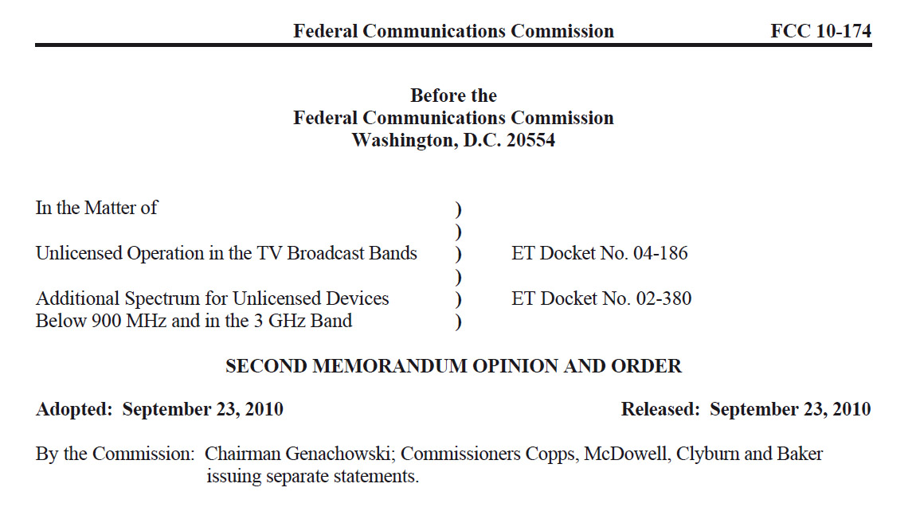
For the actual rules change go to
http://www.fcc.gov/Daily_Releases/Daily_Business/2010/db0923/FCC-10-174A1.pdf

Slide 3
Wireless microphones
The point made in paragraph 29:
We disagree with those who argue that more spectrum should be reserved for wireless microphones. We observe that wireless microphones generally have operated very inefficiently, perhaps in part due to the luxury of having access to a wealth of spectrum. While there may be users that believe they need access to more spectrum to accommodate more wireless microphones, we find that any such needs must be accommodated through improvements in spectrum efficiency.

Slide 4
Wireless microphones (2)
Reserving two vacant UHF channels for wireless microphones and other low power auxiliary service devices in all areas of the country.
Allowing operators of event and production/show venues that use large numbers of wireless microphones on an unlicensed basis that cannot be accommodated in the two reserved channels and any others available at that location to register the sites of those venues on TV bands databases to receive the same geographic spacing protections afforded licensed wireless microphones.
Eliminating the requirement that TV bands devices that incorporate geo-location and database access must also listen (sense) to detect the signals of TV stations and low power auxiliary service stations (wireless microphones).

Slide 5
Frequencies for unlicensed Television Band Devices (TVBDs)
54-60 MHz (TV channel 2),
76-88 MHz (TV channels 5 and 6),
174-216 MHz (TV channels 7-13),
470-512 MHz (TV channels 14-20)
512-608 MHz (TV channels 21-36*) and
614-698 MHz (TV channels 38-51)
*) channel 37 reserved for radio astronomy. Adjacent channels reserved for wireless microphones

Slide 6
Types of TVBDs
Fixed devices
Select channels from a TV bands database
For operation with fixed and personal/ portable TVBDs
May transmit on channels above channel 20 not adjacent to occupied TV channels
Personal/ Portable devices
Only operate on channels above channel 20
Mode II
Internal geolocation
Access to a TV bands database through internet or fixed/other Mode II device
Mode I
No Internal geolocation
No Access to a TV bands database through internet , relies on fixed/Mode II device
May not initiate a network or provide list
Sensing only device
Use spectrum sensing to make list of available channels
Under special approval regime

Slide 7
Power requirements for TVBDs
Fixed devices
Max conducted power 1 W, max e.i.r.p. 4 W
Max spectral power density 12.2 dBm/100 kHz
Personal/ Portable devices
Mode II
Max power 100 mW e.i.r.p. or 40 mW e.i.r.p. when not meeting adjacent channel requirements
Max power spectral density -1.8 dBm in adjacent channel, else 2.2 dBm/100 kHz
Mode I
Max Power Max power 100 mW e.i.r.p. or 40 mW e.i.r.p. when not meeting adjacent channel requirements
Max power spectral density -1.8 dBm in adjacent channel, else 2.2 dBm/100 kHz
Sensing only device
Max Power Max power (50) 100 mW e.i.r.p. or 40 mW e.i.r.p. when not meeting adjacent channel requirements
Max power spectral density -0.8 dBm

Slide 8
Coverage 100 mW e.i.r.p.

Slide 9
Coverage 4 W e.i.r.p.

Slide 10
Power requirements for TVBDs
Fixed devices
Max conducted power 1 W, max e.i.r.p. 4 W
Max spectral power density 12.2 dBm/100 kHz
Personal/ Portable devices
Mode II
Max power 100 mW e.i.r.p. or 40 mW e.i.r.p. when not meeting adjacent channel requirements
Max power spectral density -1.8 dBm in adjacent channel, else 2.2 dBm/100 kHz
Mode I
Max Power Max power 100 mW e.i.r.p. or 40 mW e.i.r.p. when not meeting adjacent channel requirements
Max power spectral density -1.8 dBm in adjacent channel, else 2.2 dBm/100 kHz
Sensing only device
Max Power Max power 50 mW e.i.r.p.
Max power spectral density -0.8 dBm

Slide 11
Antenna requirements
All transmit and receive antenna(s) of personal/portable devices shall be permanently attached.
The transmit antenna used with fixed devices may not be more than 30 meters above the ground. In addition, fixed devices may not be located at sites where the height above average terrain (HAAT) at ground level is more than 76 meters.

Slide 12
Emission limits
In the television channels immediately adjacent to the channel in which a TVBD is operating, emissions from the TVBD shall be at least 72.8 dB below the highest average power in the TV channel in which the device is operating.

Slide 13
Detection thresholds for sensing only devices
(i) The required detection thresholds are:
(A) ATSC digital TV signals: -114 dBm, averaged over a 6 MHz bandwidth;
(B) NTSC analog TV signals: -114 dBm, averaged over a 100 kHz bandwidth;
(C) Low power auxiliary, including wireless microphone, signals: -107 dBm, averaged over a 200 kHz bandwidth.

